Slide 1
Influencers in Online Social Network
Ryerson University—CKME 136
By: Lyndsay Roach

Slide 2


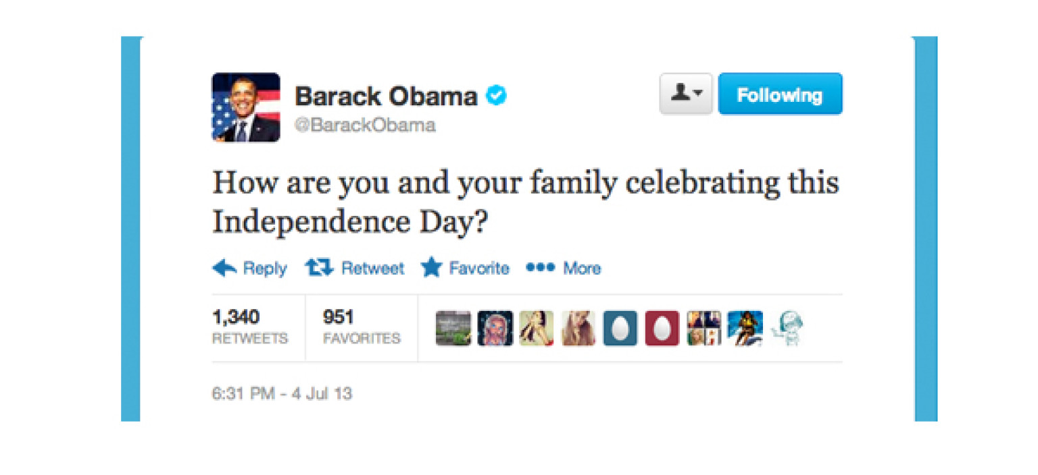
Introduction
London-based social analytics company
Measures clients social capital

Slide 3
Literary Review
1. Benevenuto, Fabrício and Meeyong Cha, Krishna P. Gummadi, Hamed Haddadi. “Measuring User Influence in Twitter: The Million Follower Fallacy,” in Proceedings of the Fourth International AAAI Conference on Weblogs and Social Media, 10-17. AAAI, 2010.
2. Fürnkranz, Johannes and Eyke Hüllermeier. “Preference Learning: An Introduction,” in Preference Learning, 1-17. Berlin: Springer-Valen, 2010.

Slide 4
Approach
Import dataset into RStudio
Explore dataset
Build logistic regression model
Compare models
Build naive Bayes model
Concluding remarks

Slide 5
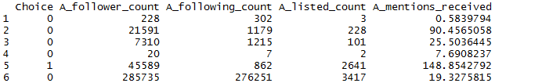
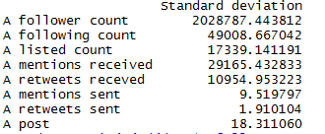
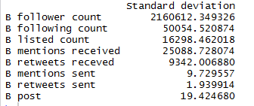
Dataset

Slide 6
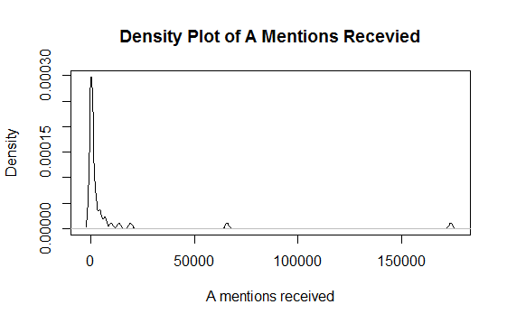
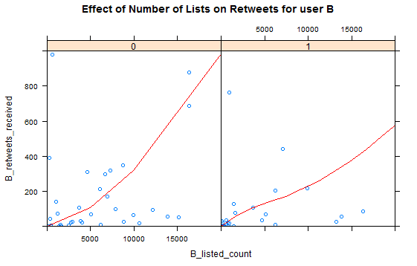
Results

Slide 7
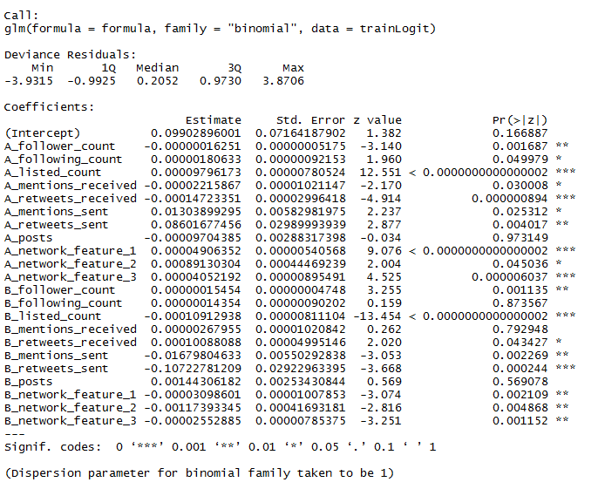


Results
Accuracy of Logistic Regression Model
Accuracy of Naïve Bayes Model

Slide 8



Conclusion
Accuracy of Logistic Regression Model
Accuracy of Naïve Bayes Model

